Slide 1
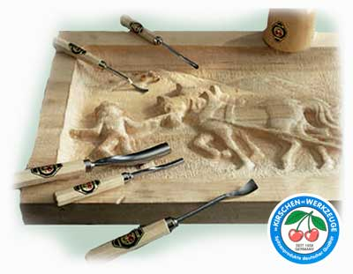
File Carving
Notes:
In this lecture, we will study file carving, an advanced topic in file system forensic analysis techniques.

Slide 2
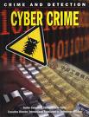
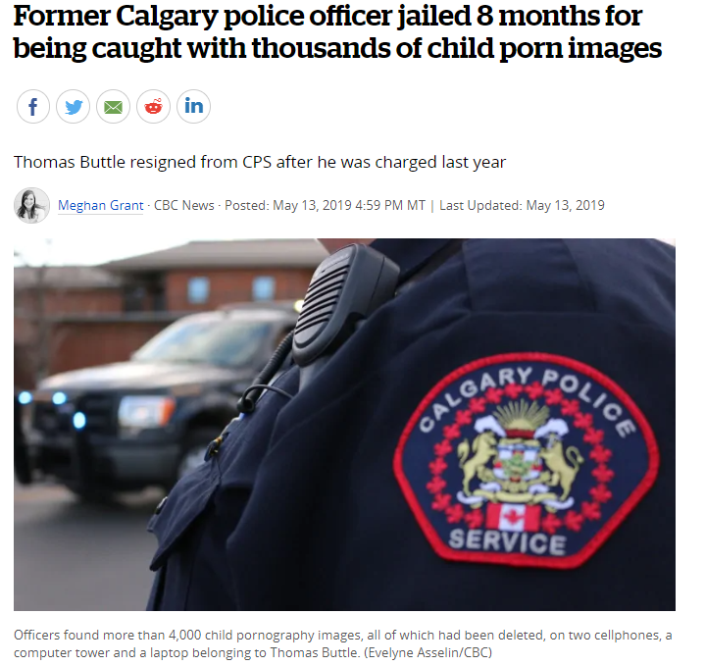
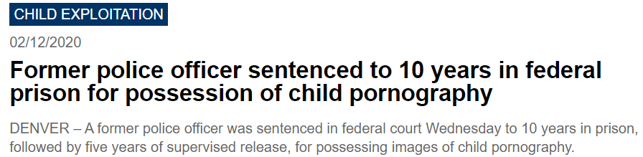
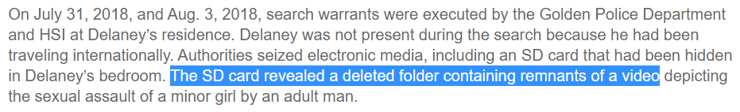
Dose of Reality:
Criminals want to erase all traces of their crimes and hide evidence of wrongdoing!
[1] https://www.cbc.ca/news/canada/calgary/thomas-buttle-child-porn-sentence-1.5133882
[2] https://www.ice.gov/news/releases/former-police-officer-sentenced-10-years-federal-prison-possession-child-pornography
Notes:
Let us take a look at the today’s world.
It is not unusual that we accidentally deleted an important file or lost files after a computer crash. Also, it is very often that criminals try to hide their wrongdoings by deleting digital evidences (e.g., downloaded illicit images or stolen confidential data or trade secret), which could indict them in the court.

Slide 3

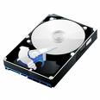
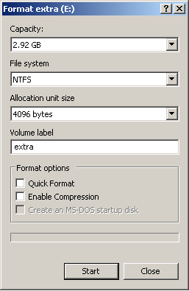
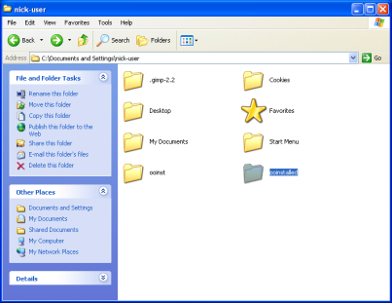



split into one or more partitions
Partition A
Volume Analysis
Partition B
Filesystem Analysis
Format (or make filesystem)
Deleted data
Notes:
Look at what we have learned so far. We know a hard disk is usually divided into several partitions. So we need to conduct volume analysis to figure out the layout of the disk. Also, each partition must be formatted with a file system. So we can save data onto these formatted partitions.
As we already known, it is very often that criminals try to hide their wrongdoings by deleting digital evidences.
Luckily, as a file is deleted, the file content still remains on your hard disk, which means that it can be recovered as far as the file content is not overwritten.

Slide 4

Dose of Reality: (cont’d)
commonly used technique
Data Recovery is one of the most common techniques in Digital Investigation.
It is used for recovering deleted data or lost data caused by various reasons, including covering up wrongdoing, damaged media.
Notes:
Therefore, it has been in high demand to recover deleted or lost files, for example, during an investigation.
As such, data recovery has become one of the most common techniques in digital investigation.
It is used for recovering deleted data or lost data caused by various reasons, including covering up wrongdoing, damaged media.
Please note that data recovery is not limited to deleted file recovery, but could mean any form of deleted data recovery, such as deleted email recovery. However, here we focus on deleted file recovery.

Slide 5

Dose of Reality: (cont’d)
Remain intact or unchanged
Data Area
File Deletion in FAT File Systems
Notes:
When a file is deleted, the contents of the deleted file remain intact or unchanged on the hard disk. However,
the operating system or the file system no longer provides any means for the user to access the deleted file.
Let’s take a look at FAT file system as an example, a popular file system still widely used today in removable media.
When a file is deleted in a FAT file system, the first letter of the file name will be replaced by a special character (0xE5), indicating that this is a deleted file. Also, all the FAT table entries related to the deleted file is wiped out and zeroed out. But the file size as well as the address of the first data block are still there, not removed.
Therefore, it is very straightforward to recover deleted files by using remaining file metadata information.
This is based on one fact that most of files are stored in contiguous space on a hard disk.
First, we scan the entire FAT file system looking for any file entries with a deletion marker (e.g. 0xE5). Then, we simply
change the first character of the file name back to its original one from 0xE5. Then,
we put back the cluster chain into FAT table since we know the starting cluster address and the file size
from the directory entry as well as the file is stored on consecutive disk blocks.

Slide 6


Dose of Reality: (cont’d)
Remain intact or unchanged
Data Area
Notes:
Unfortunately, sometimes the file system metadata information could be gone, for example, when you format a hard disk partition. Then, the only thing left for us is the file contents.
As a result, the traditional file recovery methods that make use of file system structure presented on storage devices become ineffective when the file system structure is corrupted or damaged, a task easily accomplished by a savvy criminal with freely available tools.
Since the file contents still exit, so it is possible to recover the deleted file.

Slide 7

File Carving
File Carving is the process of reassembling computer files from fragments (or data blocks) in the absence of file system metadata.
aka application-based file recovery, data carving, signature-based data recovery
A last ditch technique
or
A last data recovery technique
[1] File carving. http://en.wikipedia.org/wiki/File_carving
[2] Brien Posey. Signature-based data recovery: A last ditch technique
http://searchwindowsserver.techtarget.com/tip/Signature-based-data-recovery-A-last-ditch-technique
Notes:
A more sophisticated data recovery solution which does not rely of the file system structure is therefore necessary. These new and sophisticated solutions are collectively known as file carving. File Carving is the process of reassembling computer files from fragments (or data blocks) in the absence of file system metadata. It is known as application-based file recovery, data carving, signature-based data recovery.
It will be the last ditch technique we will resort to in order to recover the deleted data.

Slide 8

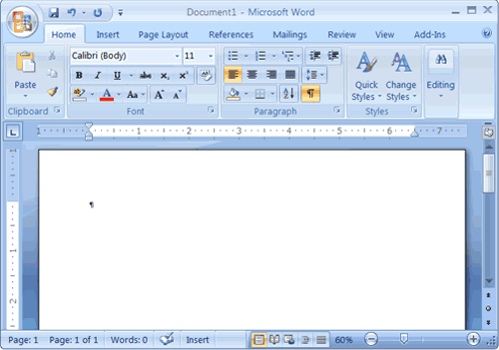


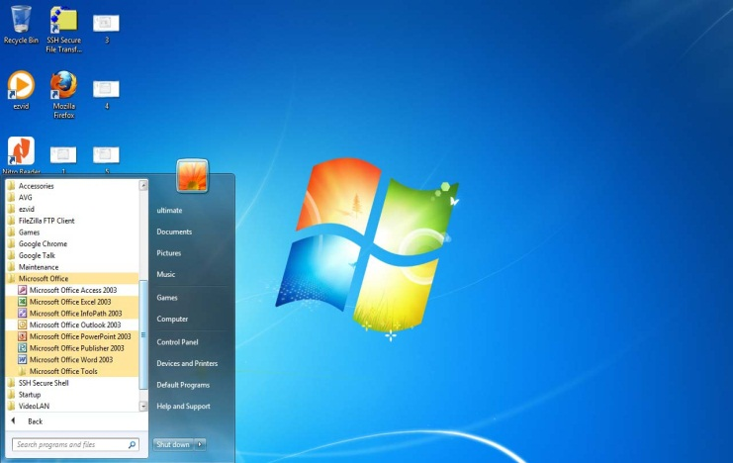
Dose of Reality:
associated with
Many Installed applications
Many File Types
Notes:
Next, let’s take a look at a reality. We install many applications on our computers, for example, Microsoft Word. Each application is associated with one specific file format, for example, we can use Microsoft Word to open Word documents.

Slide 9
Dose of Reality: (cont’d)
many file types have well-known values in an end of file (footer) or beginning of file (header)
many files are stored contiguously on disk and not broken apart. All sectors are adjacent to each other.
Header-footer carving
sector 85
sector 86
sector 87
sector 88
\xff\xd8\xff
\xe0\x00\x10
……
……\xff\xd9 ……
Blocks of raw data that can be carved to find a JPEG picture in sectors 85 to 88.
Notes:
Many file types have well-known values in an end of file (footer) or beginning of file (header).
Also, many files are stored contiguously on hard disk, and are not broken apart.
Now, it becomes very easy to recover these files if they are deleted or lost: we first look at a file header, and then look for its corresponding footer. If found, we extract the data from the header to the footer, and save them into a file. This will be the recovered deleted file. This approach is also known as Header-footer carving.
For example, A JPEG file has a unique header starting with \xff\xd8\xff\xe0\x00\x10 and a unique footer \xff\xd9.
If we find the header in hard disk sector 85, and the footer in hard disk sector 88, respectively. Blocks of raw data that can be carved to find a JPEG picture in sectors 85 to 88.

Slide 10

Dose of Reality: (cont’d)
Tools widely used for file carving: Data recovery tools play an important role in most forensic investigations because smart malicious users will always try to delete evidence of their unlawful acts. Some important data recovery tools are:
Foremost
http://foremost.sourceforge.net/
Scalpel
http://www.digitalforensicssolutions.com/ Scalpel/
[1] https://resources.infosecinstitute.com/file-carving/
Notes:
There are many tools available and widely used for file carving today. Some important tools are:
Foremost and Scalpel.

Slide 11
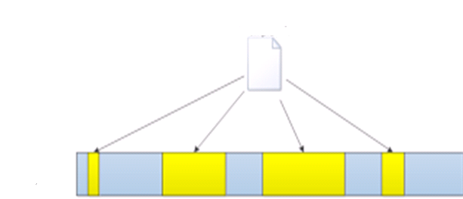

Dose of Reality: fragmented files
file pieces
File header
File footer
[1] X. Lin. Introductory Computer Forensics - A Hands-on Practical Approach. Springer 2018, ISBN 978-3-030-00580-1
Notes:
Unfortunately, it is very common that files get fragmented. So the file information is spread out over your hard disk rather than sitting in one contiguous disk space. Then, the Header-footer carving method doesn’t work.

Slide 12

Carving Fragmented Files
12
Notes:
Then, it becomes very challenging to carve out a fragmented and deleted file.
Unfortunately, many files that are of interest to detectives investigating the crimes are fragmented, such as email archives.

Slide 13

Bifragment Gap Carving (BGC)
F1
F1
F1
?
?
?
?
F2
F2
two pieces
[1] Simson Garfinkel, Carving Contiguous and Fragmented Files with Fast Object Validation, in Proceedings of the 2007 digital forensics research workshop, DFRWS, Pittsburgh, PA, August 2007
Notes:
Although it can become very difficult to recover deleted files that are fragmented, an interesting approach has been proposed to deal with a specific data recovery scenario where the deleted file is fragmented into two pieces.
Next, I will introduce the famous Bifragment Gap Carving (BGC) algorithm by Simson Garfinkel, which can carve out a deleted file that is fragmented into two pieces.

Slide 14
File Validation Check
Validation check exists for many file formats
The cyclic redundancy check, or CRC, is a technique for detecting errors in digital data, as referred to as data integrity.
In the CRC method, a certain number of check bits, often called a checksum, are appended to the data or file. Whenever the data or file has been read, we can determine whether or not the check bits agree with the data, to ascertain with a certain degree of probability whether or not an error occurred in storage or transmission of the entire data.
For example, CRC for zip files, Microsoft Office 2007 or 2010 file (.docx, .pptx, .xlsx), etc.
Notes:
Before I proceed to introduce the algorithm, I would like to introduce some techniques used in modern file systems.
The first one is File Validation Check. For example, many files use cyclic redundancy check, or CRC, to detect errors in the file data and verify the integrity of the files.
For example, CRC for zip files, Microsoft Office 2007 or 2010 file (.docx, .pptx, .xlsx), etc.

Slide 15


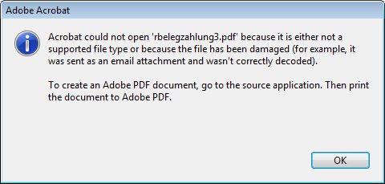
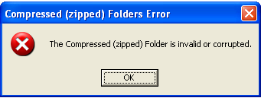
Bifragment Gap Carving (BGC) (cont’d)
If a file with a header and footer doesn’t validate, it’s possible it is fragmented.
F1
F1
F1
?
?
?
?
F2
F2
cyclic redundancy check (CRC) failure
File header
File footer
Corrupt files
Notes:
Therefore, it is very obvious that if a file with a header and footer doesn’t validate, for example, by using Cyclic Redundancy Check (CRC) Validation, it’s possible it is fragmented.
Actually, you should experience this kind of error in the past. For example, when you download a zipped file from the Internet, the file could be damaged. So when you try to open it, you will get an error message saying corrupted files.

Slide 16


BGC (cont’d)
File footer
File header
Fragmentation point
F1
F1
F1
?
?
?
?
F2
F2
Gap
Fragment
Base fragment
Notes:
Note that the problem we are looking at now is that we assume a file is fragmented into two pieces. Next, we go through some terminology.
If a file is fragmented into two pieces. The first piece is called base fragment, which starts with a unique header. The end of the base fragment is called fragmentation point.
The second piece is simply called fragment, which ends with a unique footer.
The disk space between two pieces is called Gap.

Slide 17

BGC (cont’d)
File footer
File header
F1
F1
F1
?
?
?
?
F2
F2
Maximum possible Gap
=
7 clusters
Notes:
Next, let’s take a look at a simple example. We have a file, which occupies 5 data blocks.
This file is fragmented into two pieces.
The base fragment has three data blocks, and the second piece or fragment has two data blocks. Between them, there are 4 data blocks not belonging to this file.
In other words, the gap size is 4 blocks.
Also, it is obvious that maximum possible Gap is 7 data blocks.
Please note that we assume we don’t know the file size now when trying to recovering the deleted file.
The only information that we have is the file header and file footer.

Slide 18


BGC (cont’d)
File footer
File header
f₁ clusters
f₂ clusters
Gap
=
1-7 clusters
S₁
e₁
S₂
e₂
Fragmentation point
Two variables: gap size and e₁
Notes:
It is obvious that in order to carve out the file, we need to locate the gap, where a gap can be defined by a fragmentation point e1 and a gap size g.
As such, Gap carving problem is formulated with two variables gap size g and fragmentation point e1

Slide 19


BGC (cont’d)
Two variables: gap size and Fragmentation point e₁
We can design an algorithm for checking all the possibilities for gap size and fragmentation point e₁ (Brute Force) for finding the correct gap size and fragmentation point e₁
Notes:
As Gap carving problem is formulated with two variables gap size g and fragmentation point e1
We can design an algorithm for checking all the possibilities for gap size and fragmentation point e₁ (Brute Force) for finding the correct gap size and fragmentation point e₁

Slide 20
BGC (cont’d)
BGC Algorithm: (find correct G and e₁)
File header
File footer
f₁ clusters
G
f₂ clusters
S₁
e₁
S₂
e₂
Fragmentation point
Maximum possible Gap
for G = 1 to G = e₂ – (s₁+1)
For every G, try all possible fragmentation point e₁. Note that we locate the GAP if we have known G and e₁.
Based on the guessed/know G and e₁., we extract the data as the recovered file.
Conducted file validation. If pass, we successfully recover the file. Otherwise, continue.
Notes:
The problem, which is abstracted before, can be solved by the following brute-force algorithm which check all possible gaps, where a gap can be defined by a
fragmentation point e1 and a gap size g.
Specifically, we first fix the gap size and try all the possible locations for the gap.
Note that we know the maximum gap size so the algorithm will terminate, either we find the correct gap and carve out the file or we fail to carve out the file.

Slide 21
File footer
File header
F1
F1
F1
?
?
?
?
F2
F2
S₁=0
e₁=2
S₂=7
e₂=8
Maximum possible Gap
G = e₂ – (s₁+1) = 8 – (0+1) = 7
Notes:
Next, I will use the previous example to illustrate how the Bifragment Gap Carving algorithm works.
Note that the file is fragmented into two pieces.
In the previous example, the base fragment has 3 data blocks, and the second piece or fragment has 2 data blocks. Between them, there are 4 data blocks not belonging to this file. In other words, the gap size is 4 blocks.
Also, we know that maximum possible Gap is 7 data blocks.

Slide 22

BGC (cont’d)
=1
File footer
File header
F1
F1
F1
?
?
?
?
F2
F2
G
Step 1
F1
F1
?
?
?
?
F2
F2
F1
F1
?
?
?
?
F2
F2
File Validation, for example using the CRC (Cyclic redundancy check) code of the file, such as, zipped file
Notes:
Next, let’s briefly take a look at how the BGC algorithm works.
First, we assume Gap size is 1. So the first possible location for one block gap is here, right after the first block which contains the header.
After we determinate the location of the Gap, we can extract two fragments which are assumed to be the two pieces of the file.
Then, we put them together as a whole and complete file. Afterwards, we do the file validation, for example, using the CRC (Cyclic redundancy check) code of the file, such as, zipped file to check if it is a valid file. Of course, we know the fil validation will fail.

Slide 23
=1
BGC (cont’d)
File footer
File header
F1
F1
F1
?
?
?
?
F2
F2
G
Step 1
G
Step 2
G
Step 3
G
Step 4
G
Step 5
G
Step 6
G
Step 7
Notes:
Then, we try the rest of possible locations for one-block gap. We know that all should fail to pass the file validation.
So we can conclude that our guess gap size is 1 is not correct.

Slide 24

=4
BGC (cont’d)
File footer
File header
F1
F1
F1
?
?
?
?
F2
F2
G
G
G
G
Step 1
G
G
G
G
Step 2
G
G
G
G
Step 3
F1
F1
F1
F2
F2
Notes:
Finally, suppose we start to try 4-block gap.

Slide 25


We convert (formulate) a real world problem - Carving Fragmented Files into a research problem (Particularly can be solved using algorithms)
We solve it in a Computer Science way!
Notes:
We convert (formulate) a real world problem - Carving Fragmented Files into a research problem (Particularly can be solved using algorithms).

Slide 26

Dose of Reality:
Files fragmented with more than 2 pieces
Notes:
How about Files fragmented with more than 2 pieces? I will say it is still an open problem.
Unfortunately, some files, which are of interest to a forensic investigator, are fragmented into more than 2 pieces. For example, Email archive files, due to its big size, which could be fragmented into more than 2 pieces.

Slide 27
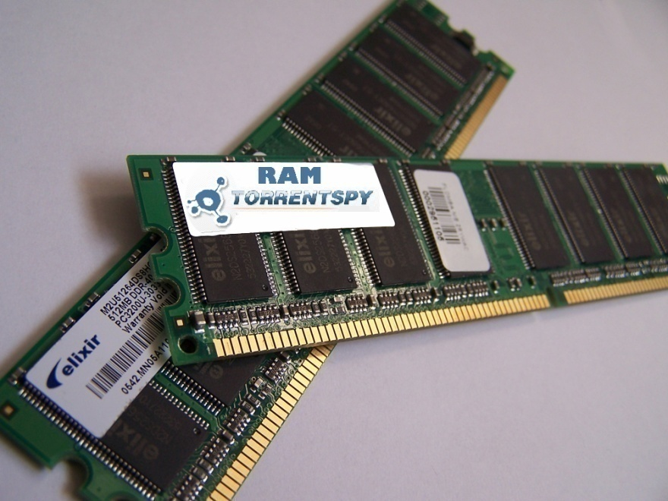
Volatile Data Forensic Analysis
(Memory Forensics or Live Forensics)
27
Notes:
Next, we will look at Volatile Data Forensic Analysis, aka Memory Forensics or Live Forensics.

Slide 28

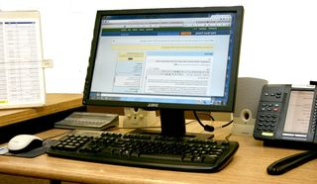


Dose of Reality:
Notes:
Sometimes, when you come to a crime scene, for example, discovering some computer or mobile devices still on. So we must use the live analysis to collect data, particularly the volatile information of system, including which the TCP and UDP ports are opened, user login history, what services are activated currently, etc.
Those information of volatile may disappear from the computer after the shut down.

Slide 29

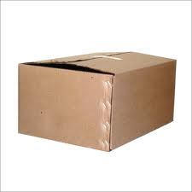



Dose of Reality: (cont’d)
Notes:
Before I discuss live analysis in more detail, I would like to talk about something you are very familiar with.
When you receive a fragile package, you will be careful when handling it.

Slide 30
Volatile Data
Volatile Data: data can be lost when shutting down or rebooting the machine, including
Memory contents
A swap file (or swap space or, in Windows NT, a pagefile), a space on a hard disk used as the virtual memory extension of a computer's real memory (RAM)
Network Connection and Open ports
System processes
Logged on users
Buffers
Clipboard, a software facility that can be used for short-term data storage and/or data transfer between documents or applications, via copy and paste operations
Notes:
Similarly, we are talking about how to handle a special type of the data, volatile data, which refers to data can be lost when shutting down or rebooting the machine.
We also must be very careful when handling volatile data.

Slide 31

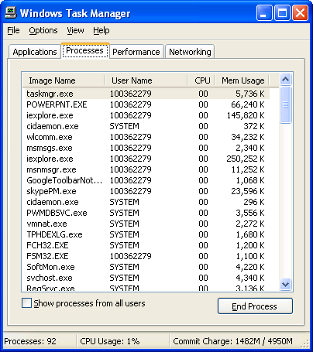


Notes:
For example, this is Windows Task Manager, which shows a list of currently running processes in a computer.
[click]
Then, these information will be gone when shutting down or rebooting the machine.

Slide 32
Data Acquisition and the Order of Volatility (cont’d)
Computers store a great amount of information in a significant number of locations and layers. Disk storage and Random access memory (RAM) are the two most commonly thought data repositories.
All data is volatile, however. As time passes the veracity of the information goes down, and the ability to recall or validate the data also decreases.
However, some data is MORE volatile.
[1] Order of volatility. http://www.macforensicslab.com/ProductsAndServices/
index.php?main_page=document_general_info&cPath=5_24&products_id=213
Notes:
Computers store a great amount of information in a significant number of locations and layers. Disk storage and Random access memory (RAM) are the two most commonly thought data repositories.
Overall, all data is volatile, however. As time passes the veracity of the information goes down, and the ability to recall or validate the data also decreases.
However, some data is MORE volatile.

Slide 33

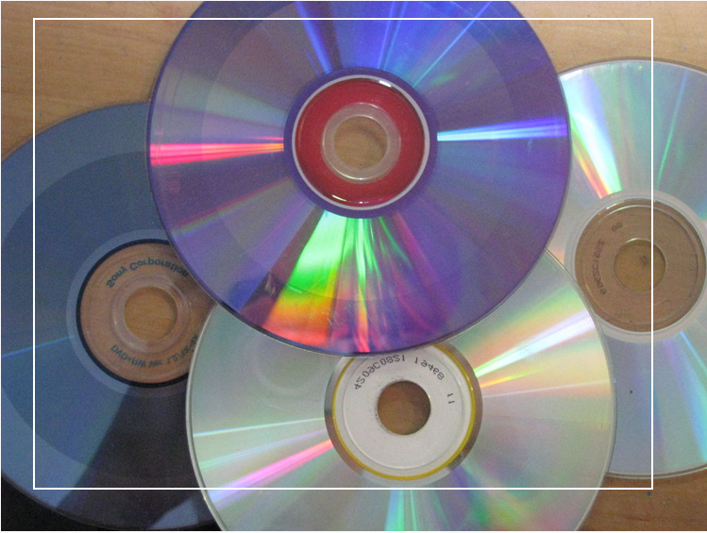
Data Acquisition and the Order of Volatility (cont’d)
A book published in 1857
unreadable DVD
Notes:
All data is volatile, even including hard copy books and DVD. For example, a book published in 1857 becomes unreadable. Also, a DVD may become unreadable after years.

Slide 34
Data Acquisition and the Order of Volatility (cont’d)
Thus, when collecting data for a computer forensic investigation you want to collect the most volatile data first as it will be lost the quickest.
- The order of volatility shows which data will be lost first.
[1] Order of volatility. http://www.macforensicslab.com/ProductsAndServices/
index.php?main_page=document_general_info&cPath=5_24&products_id=213
Notes:
Thus, when collecting data for a computer forensic investigation you want to collect the most volatile data first as it will be lost the quickest. The order of volatility shows which data will be lost first.

Slide 35
Data Acquisition and the Order of Volatility (cont’d)
high
Registers, peripheral memory, caches, etc. | nanoseconds
Main Memory | nanoseconds
Network state | milliseconds
Running processes | seconds
Floppies, Hard disk, backup media, etc. | years
CD-ROMs, printouts, etc. | tens of years
The order of volatility in which data will be lost first.
The expected lifespan of data
[1] http://www.porcupine.org/forensics/forensic-discovery/appendixB.html
Notes:
Each type of data has certain lifespan. This is the expected lifespan of different types of data. The shorter the expected lifespan of data is, the higher volatile the data is.
In an order of the most to the least fragile evidence, you should collect forensic evidence from main memory, network state information, kernel statistics, temporary file systems, remote logging and monitoring data that is relevant to the system in question, physical configuration, network topology, and finally from archival media, such as hard disks, CD-ROMs.

Slide 36
Data Acquisition and the Order of Volatility (cont’d)
high
Memory contents
Swap files
Network processes
System processes
File system information
Raw disk blocks
volatile
The order of volatility in which data will be lost first.
Memory contents, swap files, network processes, and system processes will all be lost when the suspect system is shut down or rebooted. We call this type of data volatile.
Notes:
While it is a fact that all data is volatile.
However, volatile data usually refers to this type of data, which will all be lost when the suspect system is shut down or rebooted, including Memory contents, swap files, network processes, and system processes.

Slide 37

Volatile Data Acquisition and Analysis (Memory Forensics or Live Forensics)
Why Memory Forensics?
Volatile Data on running computers can provide crucial evidence, for example,
Running processes.
Executed console commands.
Passwords in clear text.
Unencrypted data.
Internet Protocol (IP) addresses.
Network connection and open ports
Worm/Trojan Horse/Rootkit.
Encryption keys
Web caches
[1] Todd G. Shipley and Henry R. Reeve. Collecting Evidence from a Running
Computer: A Technical and Legal Primer for the Justice Community
http://www.search.org/files/pdf/CollectEvidenceRunComputer.pdf
Notes:
Why we need to do memory forensics and analyze the data in RAM. This is because volatile Data on running computers can provide crucial evidence, for example,
[click]
Passwords in clear text

Slide 38

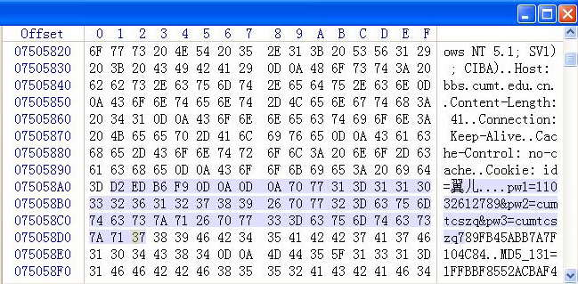
Volatile Data Acquisition and Analysis (Memory Forensics or Live Forensics)
User id
old passwd
new passwd
The process of a user changing his/her password on a Website
[1] Q. Zhao and T. Cao. Collecting Sensitive Information from Windows Physical Memory. JOURNAL OF COMPUTERS, VOL. 4, NO. 1, JANUARY 2009
http://www.academypublisher.com/jcp/vol04/no01/jcp0401003010.pdf
Notes:
This is an example showing you are able to find some passwords used by a user.

Slide 39
Volatile Data Acquisition and Analysis (Memory Forensics – cont’d)
Why Memory Forensics? (cont’d)
physical memory of a computer can be a very useful yet challenging resource for the collection of digital evidence
Computer Live Forensics Based on Physical Memory Analysis
But …
All actions you perform affect memory
No data integrity
Sometime cannot be reproduced (Document what you did)
[1] Todd G. Shipley and Henry R. Reeve. Collecting Evidence from a Running
Computer: A Technical and Legal Primer for the Justice Community
http://www.search.org/files/pdf/CollectEvidenceRunComputer.pdf
Notes:
However, it could be very challenging to conduct live analysis.
This is because when a live system analysis is performed, there is almost always some system alteration, with the exception of network monitoring.
For example, running any process will at a minimum alter the CPU registers in addition to some memory and possible disk space as well. Therefore, the key to a successful live analysis from an investigative perspective is: First, understand and document how a live analysis is being performed.
Further, some alteration is unavoidable in a live system analysis. We have to minimize the amount of alteration. When deciding on an approach to analyzing a live system, consideration must be given to the least disruptive way of accomplishing this. If the investigator wants to know what ports are accessible from a given IP address, an external port scan may be the least intrusive .

Slide 40
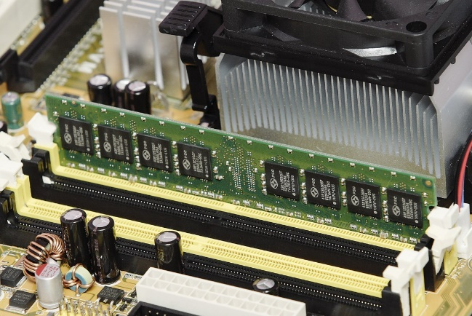

Detecting data structure in memory is very challenging
User id and password
Encryption key
……
[1] Z. Lin, et al, Automatic Reverse Engineering of Data Structures from Binary Execution. NDSS 2010
[2] A. Cozzie, et al, Digging for data structures. In Proceedings of the 8th USENIX conference on Operating systems design and implementation (OSDI'08). USENIX Association, USA, 255–266.
[3] F. Pagani, et al, AutoProfile: Towards Automated Profile Generation for Memory Analysis, ACM Transactions on Privacy and Security, vol. 25, no. 6, February 2022, pp 1–26
[4] Z. Qi, et al, LogicMEM: Automatic Profile Generation for Binary-Only Memory Forensics via Logic Inference, NDSS 2022

Slide 41
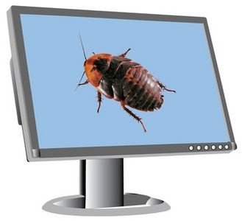

Dose of Reality:
We Don't Trust Computing Environment Used or Compromised by the Suspect
Notes:
Also, do not trust tools on the system. Where possible, use tools that you provide to perform a live system analysis. If a system compromise is suspected, built-in tools may be modified to provide false data or hide specific system activities.

Slide 42

The Right “Tool”
Notes:
So we need right tools for live analysis.

Slide 43




Making Your Own Tool Kit
Notes:
Specially, we will have to build up our own tools. For example, Live CD/DVD or Live USB, which is a kind of operation system distribution which can be booting from a read-only medium (such as a CD-ROM) without installing into hard disk.
It also contains some forensic tools, such as RAM and disk imaging tool.

Slide 44

Notes:
Next, let’s take a look at some common live analysis tools for Windows system.

Slide 45

Memory Forensics - Microsoft Tools
Network tools
netstat -a, nbtstat, ping, tracert, arp, netsh, ipconfig
Services
net start/stop, sc, services.msc
Process
tasklist, taskkill, schtasks
Logged on users
Administrative Tools\Computer Management, Under Shared Folders\Shares or Sessions
Displays the amount of used and free memory in your system
mem
systeminfo (Windows 7)
Notes:
For example, you can use the Windows utility netstat to display all the network connections on the system.
Also, you can use the Windows utility tasklist to display a list of currently running processes on the computer.

Slide 46


Notes:
Next, let’s take a look at some common live analysis tools for Linux system.

Slide 47

Memory Forensics - Linux Tools
Network tools
netstat, ping, tracert, arp, ifconfig
Services
service
Open files
lsof
Process
ps
Logged on users
who, whoami
How long the system has been running
uptime
Notes:
For example, you can use the Linux utility netstat to display all the network connections on the system.
Also, you can use the Linux utility who to list the currently logged on users.

Slide 48
Memory Forensics - Linux Tools (cont’d)
Show who is logged on and what they are doing
w
Display top CPU processes/Linux tasks
top
Display amount of free and used memory in the system
free
Manipulate the history list
history
Notes:
Also, for example, you can use the Linux utility w to show who is logged on and what they are doing.
Also, you can use the Linux utility history to show all of the last commands that have been recently used by the user.

Slide 49
Memory Forensics - External Tools
http://www.moonsols.com/windows-memory-toolkit/
MoonSols Windows Memory Toolkit
- Windows Physical Memory Imaging Utility - Windd
http://gmgsystemsinc.com/fau/
Forensic Acquisition Utilities: a collection of utilities and libraries intended for forensic or forensic-related investigative use in a modern Microsoft Windows environment, such as dd.
Linux also has dd command.
For example, dd if=<physical memory device name> conv=noerror of=<blah.dat>
Where, Linux: /dev/mem
Windows: \\.\PhysicalMemory *
Notes:
Some live analysis tools can not be found in Windows and Linux systems. You will need external tools from some third party. For example, Windows Physical Memory Imaging Utility – Windd or Forensic Acquisition Utilities (fau) to image the physical memory. Please note that in Linux system, you can use the utility dd (or dcfldd) to capture the contents of physical memory using a device file (e.g. /dev/mem for the physical system memory). However, many Linux distributions disable them by default for security reasons.

Slide 50

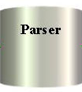
Memory Forensics - External Tools (cont’d)
https://www.volatilesystems.com/default/volatility
The Volatility Framework: Volatile memory artifact extraction utility framework
http://sourceforge.net/projects/memparser/
MemParser: reconstructs a process list and extracts information from a process memory
http://www.foundstone.com/us/index.asp
Foundstone Free Tools, for example, fport
http://www.sysinternals.com
Variety of Windows tools to monitor and analyze, for example, TCPView
Rootkit and Malware Detection Tools^{[1]}
[1] Jay Turla. Free & Open Source Rootkit and Malware Detection Tools
https://resources.infosecinstitute.com/topic/free-detection-tools/
Notes:
Another popular memory forensics tool is The Volatility Framework, which is Volatile memory artifact extraction utility framework.
Also, Foundstone provides a bunch of very useful Forensic Analysis Tools. For example, fport can be used to will identify the specific applications that open ports on your system.
Also, Attackers often use rootkits to hide malware on a computer in a way that allows it to persist undetected over time. When the computer is infected, a rootkit can steal data or resources, or surveil communications.
A rootkit most of the time will try to conceal the presence of the rootkit.
Often the best way to determine if a machine is infected by a rootkit is to look into the memory directly to detect rootkits, for example, using some Rootkit detection Tools. For example, The Volatility Framework provides various plugins to detect rootkit concealment techniques as well.

Slide 51


Volatile Data Acquisition and Analysis
Acquisition
physical memory image
Offline analysis of mem dump
Software/hardware
Proceed with Dead Analysis
Volatile Data Forensics Process
Notes:
So a popular roadmap for Volatile Data Acquisition and Analysis is as flows:
If the computer is still active when arrived at the crime scene, you will need to acquire physical memory. Afterwards, the acquired physical memory image can be analyzed. In the end, dead analysis still has to be performed. For example, creating the disk image and then perform volume analysis and then conduct file system analysis.

Slide 52
Volatile Data Acquisition and Analysis (cont’d)
Keyword Searching
File Signature Search
Acquisition
physical memory image
View data
Memory parse
Live file carving
Notes:
After you have created a physical memory image, you can conduct a forensic analysis on the physical memory image using different analysis techniques, including Keyword Searching, File Signature Search, display or view data, parse and extract useful information from the memory (e.g., reconstructs a process list).
Also, you can carve out the files in the memory.

Slide 53
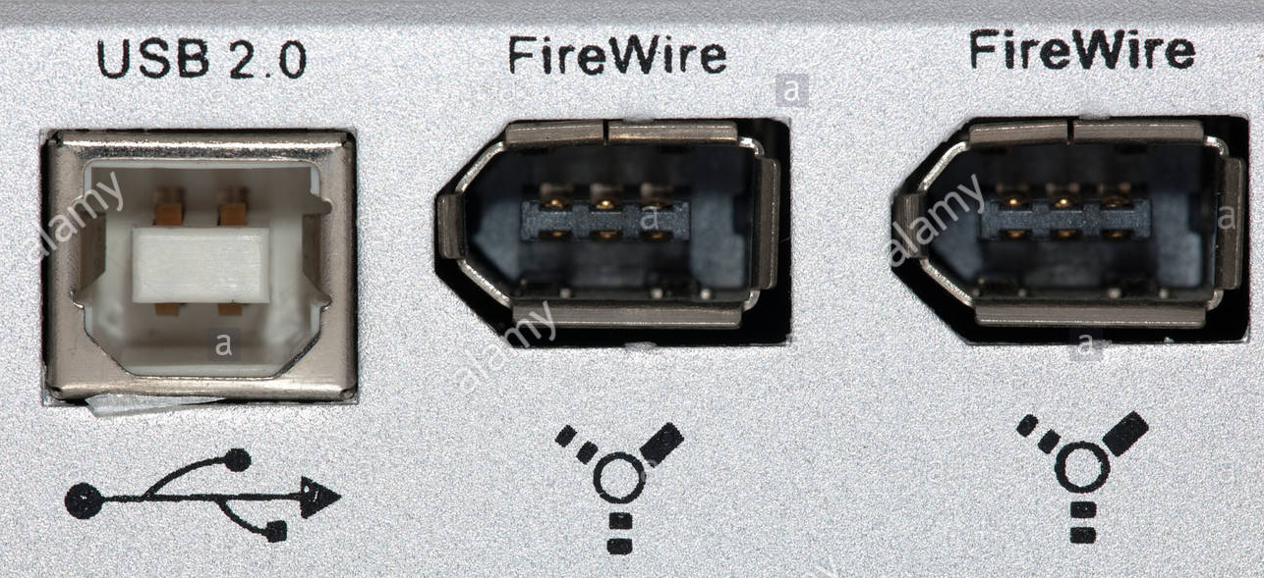

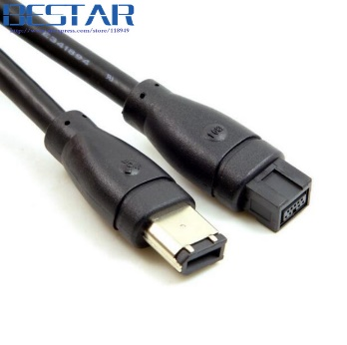
Volatile Data Acquisition Methods
Volatile Data Acquisition can be
Hardware-based: Access memory directly to copy contents of physical memory,
Custom hardware devices
DMA (Direct Memory Access)
IEEE 1394 Firewire connection
allows for a direct access to the system RAM of a target machine
Software-based, such as Windd for windows or dd for Linux
Trusted toolkit
Will alter memory
May overwrite evidence
Both can be cheated.
IEEE 1394 cable - 9 Pin to 6 Pin FireWire 800
Notes:
Volatile Data Acquisition can be Hardware-based method and Software-based method.
However, Software-based ones have one big disadvantage: it will alter memory, and as a result, it may overwrite some evidence.
But Hardware-based methods, which accesses memory directly to copy contents of physical memory, is also not perfect. It needs hardware devices or interface support. For example, you need to use Firewire interface to dump the system RAM of a target machine.
No matter which data Acquisition method you want to use, you must realize that both can be cheated. For example, the suspects may modify their computer's hardware (Firewire interface) or kernel module for memory access.

Slide 54

Volatile Data Collection Process
Collect uptime, date, time, and command history for the security incident.
As you execute each forensic tool or command, generate the date and time to establish an audit trail.
Begin a command history that will document all forensic collection activities.
Collect all types of volatile system and network information.
End the forensic collection with date, time, and command history.
[1] Richard Nolan, Colin O’Sullivan, Jake Branson, and Cal Waits.
First Responders Guide to Computer Forensics
http://www.sei.cmu.edu/library/abstracts/reports/05hb001.cfm
Notes:
This is a standard Volatile Data Collection Process.
Nevertheless, the key to a successful volatile data collection is to document all your activities. This is very critical.

Slide 55



Acquisition
dd (dcfldd)
Notes:
Next, we will do some case studies about Volatile Data Forensic Analysis. First, we take a look at a quick look at data acquisition, particularly, how to capture the contents of physical memory using software-based methods, for example, using dd or dcfldd in Linux.

Slide 56
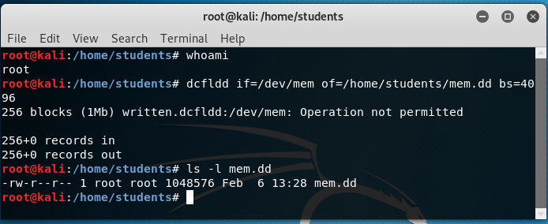
Acquire physical memory in Linux
Notes:
When capturing the contents of physical memory using software-based methods, for example, using dd or dcfldd in Linux, you must be a super user.
This is an example of using dcfldd.

Slide 57
Keyword Search
srch_strings
grep
Notes:
After you have a physical memory image, you can use the Keyword Search technique to search for known keywords in the image. Remember what we did before:
The memory image is a bunch of binary data. Therefore, we also first need to extract printable data from a binary memory image, for example, using TSK’s srch_strings command. Afterwards, we can search the keyword within the output .asc file from TSK’s srch_strings command.

Slide 58
Analyze RAM with Volatility
Volatility Framework
Notes:
Next, I will introduce a popular volatile data forensic analysis tool: The Volatility Framework, which is an open source memory analysis framework that works on memory dumps from OS X, Windows, Linux, and Android.

Slide 59


Analyze RAM with Volatility (cont’d)
The Volatility Framework currently provides the following extraction capabilities for memory samples
Image date and time, Running processes, Open network sockets, Open network connections, DLLs loaded for each process
Open files for each process, Open registry handles for each process
A process' addressable memory
OS kernel modules
Scanning examples: processes, threads, sockets, connections, modules
Extract executables from memory samples
Transparently supports a variety of sample formats (ie, Crash dump, Hibernation, DD)
……
Online help, type:
volatility -h
Or (earlier installation)
python volatility
Volatility Framework
Notes:
For example, it provides the extraction capabilities for a memory image to display the image date and time, a list of running processes.

Slide 60


Example volatile memory image, “memory-images.rar”
http://www.cfreds.nist.gov/mem/memory-images.rar
RAM image
xp-laptop-2005-07-04-1430.img
Notes:
Next, let us play a little bit with an example volatile memory image.

Slide 61
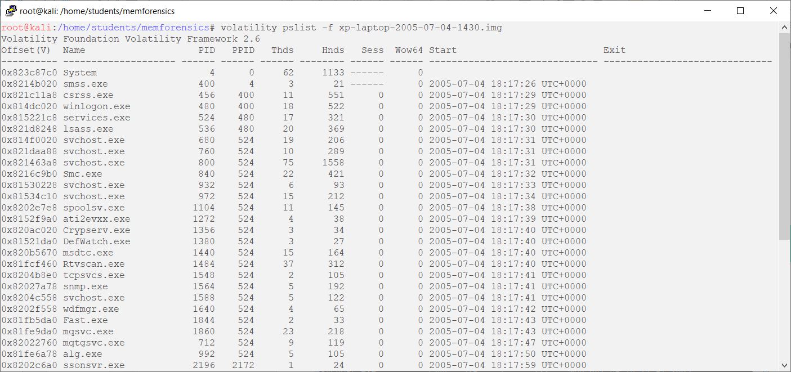
Analyze RAM with Volatility (cont’d)
currently running processes
Notes:
You can use the option pslist to list the currently running process from this memory image.

Slide 62
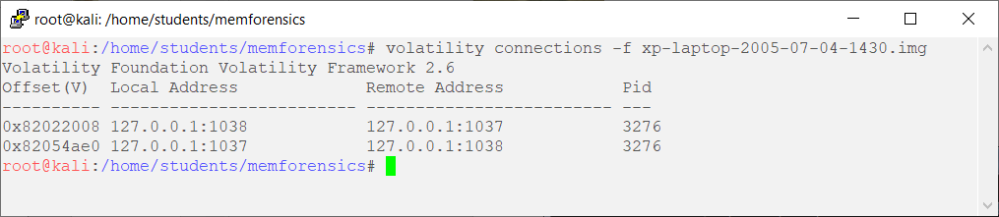
Analyze RAM with Volatility (cont’d)
The list of open connections
Notes:
Also, you can use the option connections to show the list of open connections from this memory image.

Slide 63
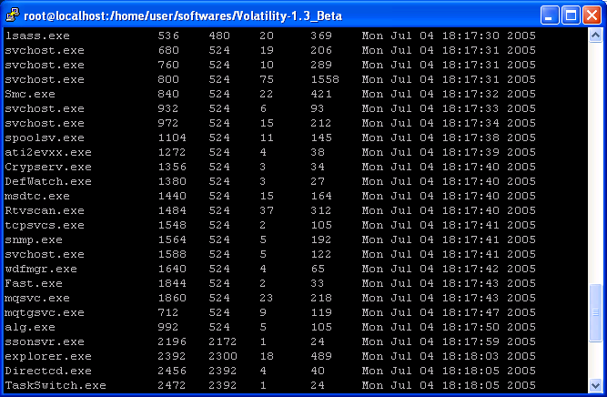

Analyze RAM with Volatility (cont’d)
Notes:
However, we have a problem: sometimes we don’t have a clue what a process is if we look at the name of a process.
[click]
For example, what is Fast.exe?

Slide 64
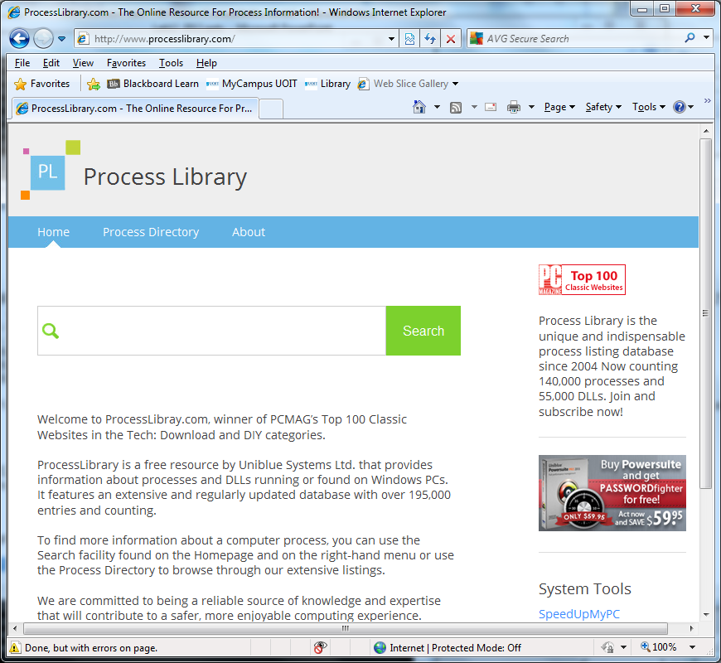
Analyze RAM with Volatility (cont’d)
Notes:
So you can go to ProcessLibrary.com, and find out information about processes and DLLs running or found on Windows PCs.

Slide 65

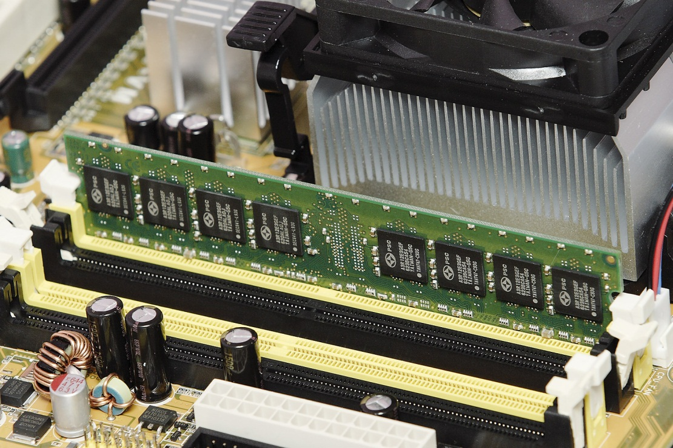

A lot of files!
Dose of Reality:
Notes:
You may be surprised that there are a lot of files in your physical memory. For example, the images you've downloaded from the websites.

Slide 66
Live File Carving with Scalpel
filesystem-independent
Assume the data blocks of the files to reside sequentially in the image under investigation, and then recover files based on their headers, footers (the file size), and internal data structures.
Scalpel
Notes:
Your computer memory doesn’t have any file system structure. However, we can use file carving techniques to recover these files cached in the memory.
For example, using scalpel.

Slide 67

Reading materials
Chapter 9
Andreas Schuster. Windows Memory Forensics with Volatility
https://www.first.org/resources/papers/conference2009/schuster-andreas-sliders.pdf
Memory Forensics and Analysis Using Volatility.
https://resources.infosecinstitute.com/memory-forensics-and-analysis-using-volatility/#gref
Hal Pomeranz. Detecting Malware With Memory Forensics.
http://www.deer-run.com/~hal/Detect_Malware_w_Memory_Forensics.pdf

